Slide 1
Impossible Row
Team Become the First Ever to Row to Antarctica

Slide 2
Daily News
Inspirational x World News x
20th January 2020
Team Become the First Ever to Row to Antarctica
Six rowers have smashed world records and achieved something no one else has. They have rowed to Antarctica!
The Drake Passage is a waterway between Chile and Antarctica. In the past, it’s been thought to be one of the most treacherous stretches in the world.
A team of six took just over 12 days days to row across the Drake Passage. It was called ‘the impossible row.’ They took it in turns to row and slept on the rowing boat!
They navigated across 600 miles. That’s about the length of the whole of the United Kingdom.
No one else has ever rowed across the Drake Passage. According to the Guinness World Records’ website, they broke nine records!
One of those records was achieved by rower Fiann Paul. With ‘the impossible row’ he’s become the first person to row on all five oceans!
Over 100 years since the first person reached the South Pole, adventurers are still exploring the distant parts of our world.
Read the full article online here.
What is the Drake Passage?
Who was the first person to reach the South Pole?
How are other explorers making the news?
Photo: Approaching Antarctica from the sea.
Click here to explore the 60-Second Read
Notes:
Teacher Note - Please do not let the next video automatically play at the end of the clip. Please check the content in this link, including any comments, is suitable for your educational environment before showing. Twinkl accepts no responsibility for the content of third party websites.

Slide 3
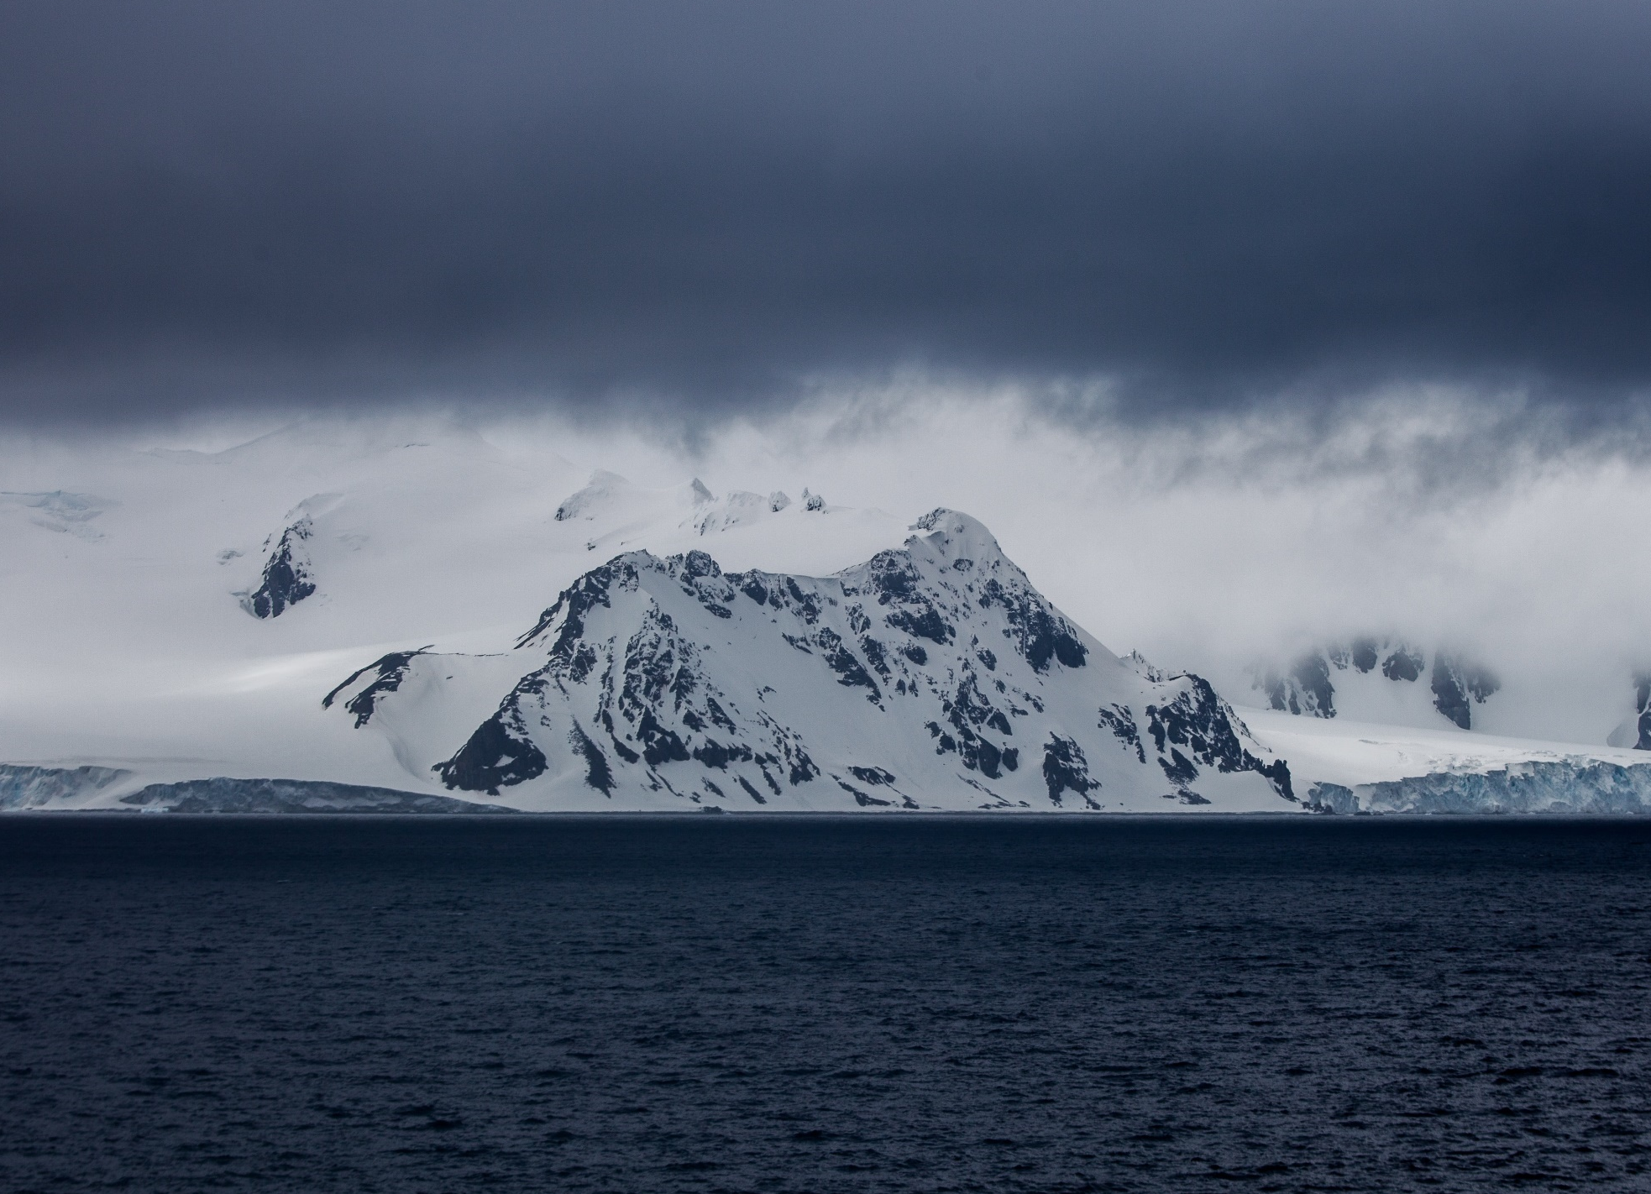

Slide 4
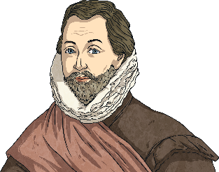
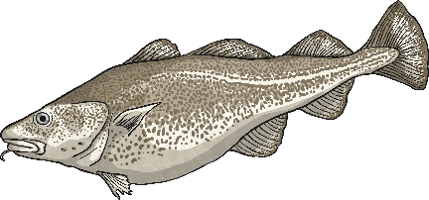
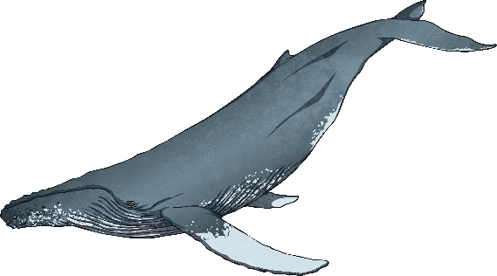
What Is the Drake Passage?
environment
variety
The Drake Passage is a stretch of water between Chile and Antarctica.
The Drake Passage is known as a treacherous environment. Bad weather and large waves make it difficult to sail in.
It divides the Atlantic Ocean and the Pacific Ocean.
However, there is a wide variety of animal life in this part of the ocean.
The Drake Passage is named after English explorer Sir Francis Drake.
Whales, fish, penguins and dolphins can all be found in the ocean here.
Use an atlas or world map to find the Drake Passage.
He went through it when he became the first Englishman to sail around the world.
Find three facts about the Drake Passage.

Slide 6
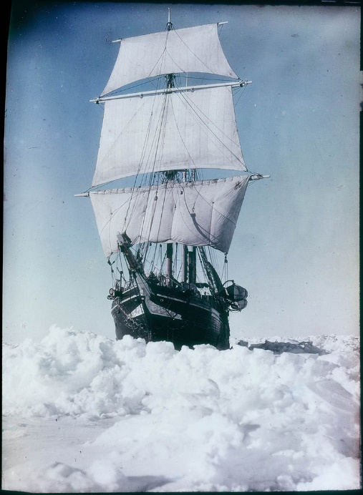
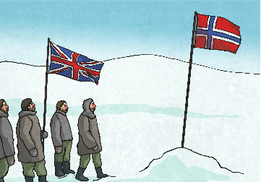
Who Was the First Person to Reach the South Pole?
competition
opportunity
temperatures
Many people have raced to be the first to reach the poles. Competition has been fierce!
They tried again in 1908 but they had to turn back.
In 1911, they set out again. However, a team from Norway were also racing to the South Pole.
In 1901, Ernest Shackleton and Robert Scott had an opportunity to be the first to reach the South Pole.
On the 14th December 1911, Norwegian explorer Roald Amundsen reached the South Pole.
Write a headline about the first person to reach the South Pole.
They beat Shackleton and Scott. A British team arrived in January 1912.
Unfortunately, freezing temperatures and illness meant they had to turn back.
Find a piece of evidence that suggests Shackleton was determined.

Slide 8
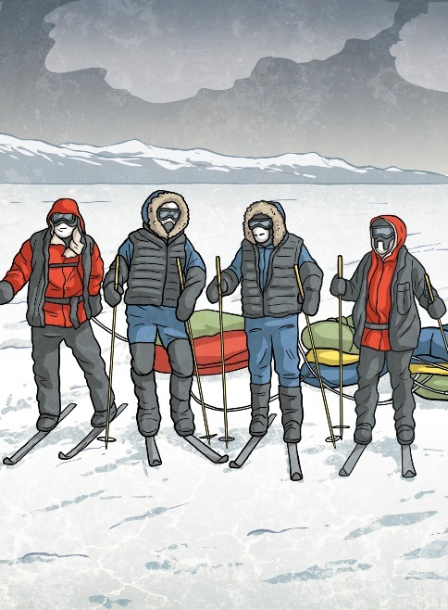
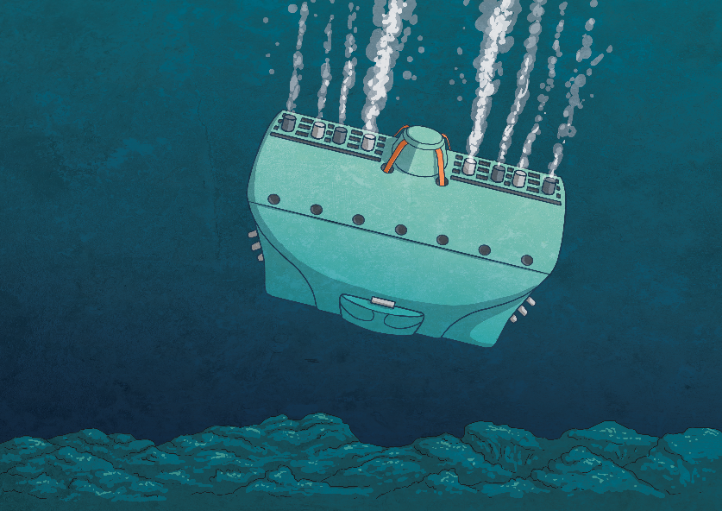
How Are Other Explorers Making the News?
achievements
individual
vehicle
Recently, different explorers have made headlines for their achievements.
He did it in a record time: six months and six days!
In September, Victor Vescovo became the first individual to dive to the bottom of all of the world’s oceans!
In December 2019, two men walked using skis to travel across the Arctic Circle.
It took them nearly three months to complete!
Work with a group and discuss which achievements you’d like to make in 2020.
Back in November, Nirmal Purja climbed all 14 of the tallest mountains in the world.
He used a special type of submarine called a Deep Sea Vehicle, designed for the ocean depths.
Find a word meaning accomplishment.

Slide 9
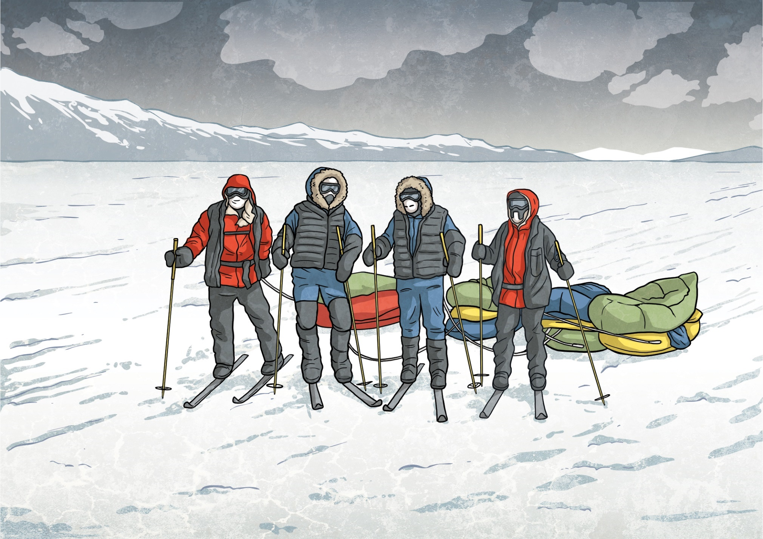

Slide 12
Glossary
Word | Definition
waterway | A route for travel by water.
stretches | A continuous area of land or water.
navigated | To have planned and travelled along a route, often by ship.
adventurers | A person who seeks adventure or wants to explore something new.

